Slide 1
VISITOR MANAGEMENT SYSTEM

Slide 2
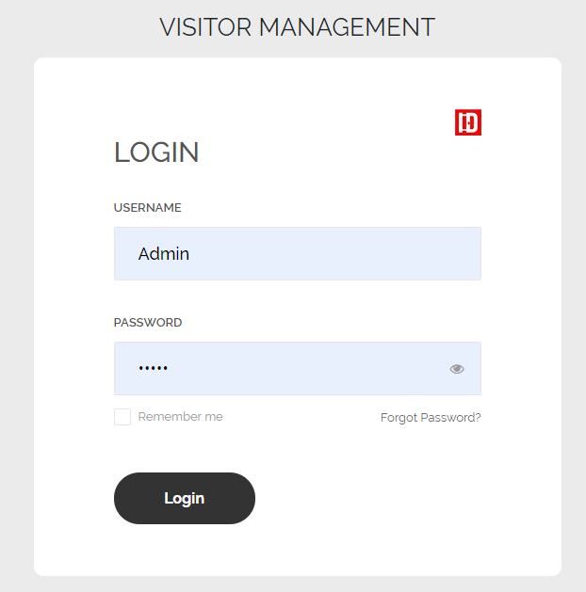
Login Page

Slide 3
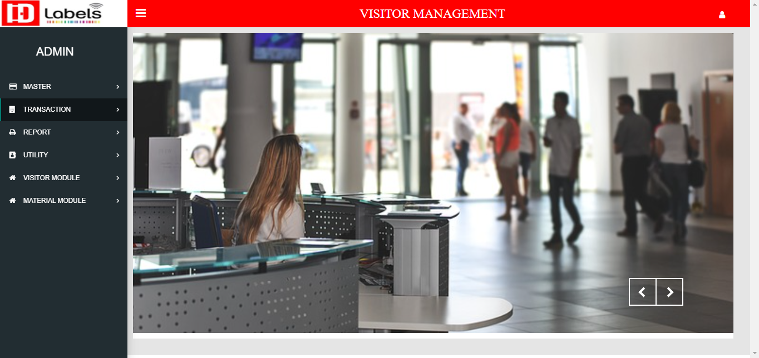
Landing Page
This is Landing Page of Master Module
Sidebar Hide Show Button
Logout
Button

Slide 4
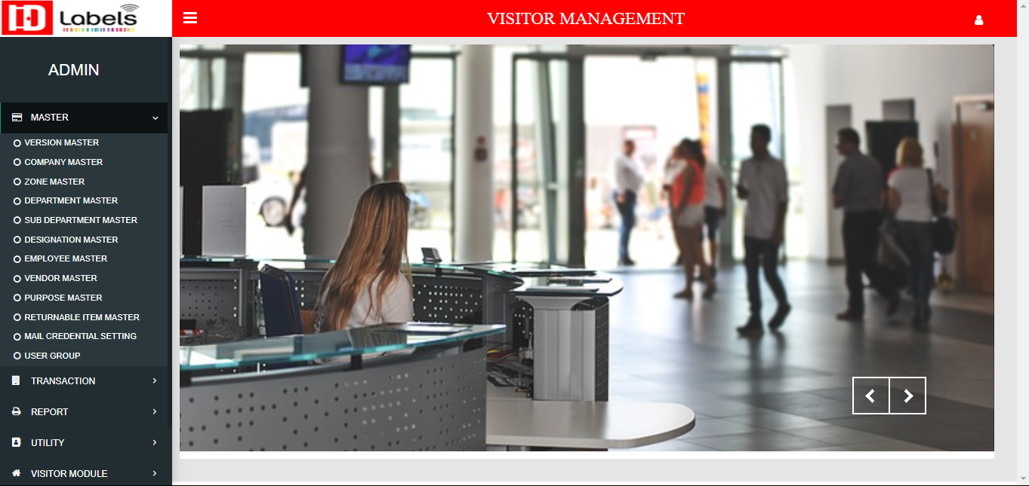
Master
The Sidebar contains Dropdown of Master, Transaction
Report, Utility And Version module

Slide 5
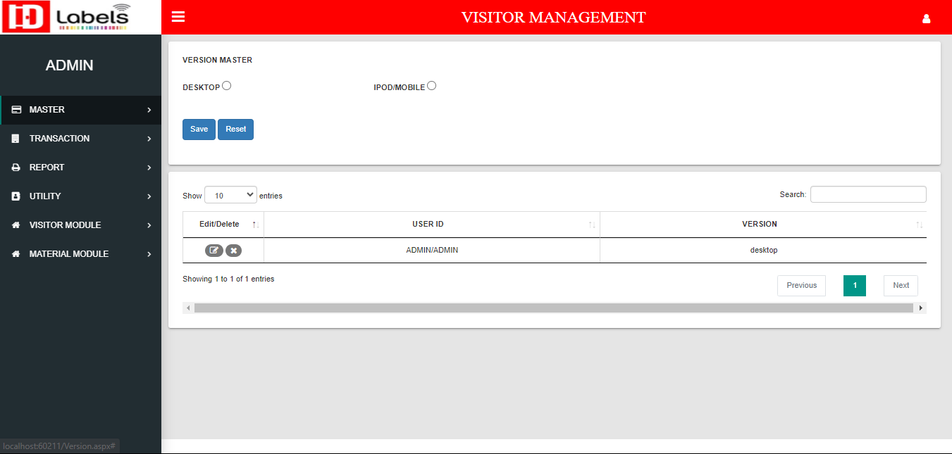
Version Master
Here we assign user to use in which device either its desktop or Ipad.

Slide 6
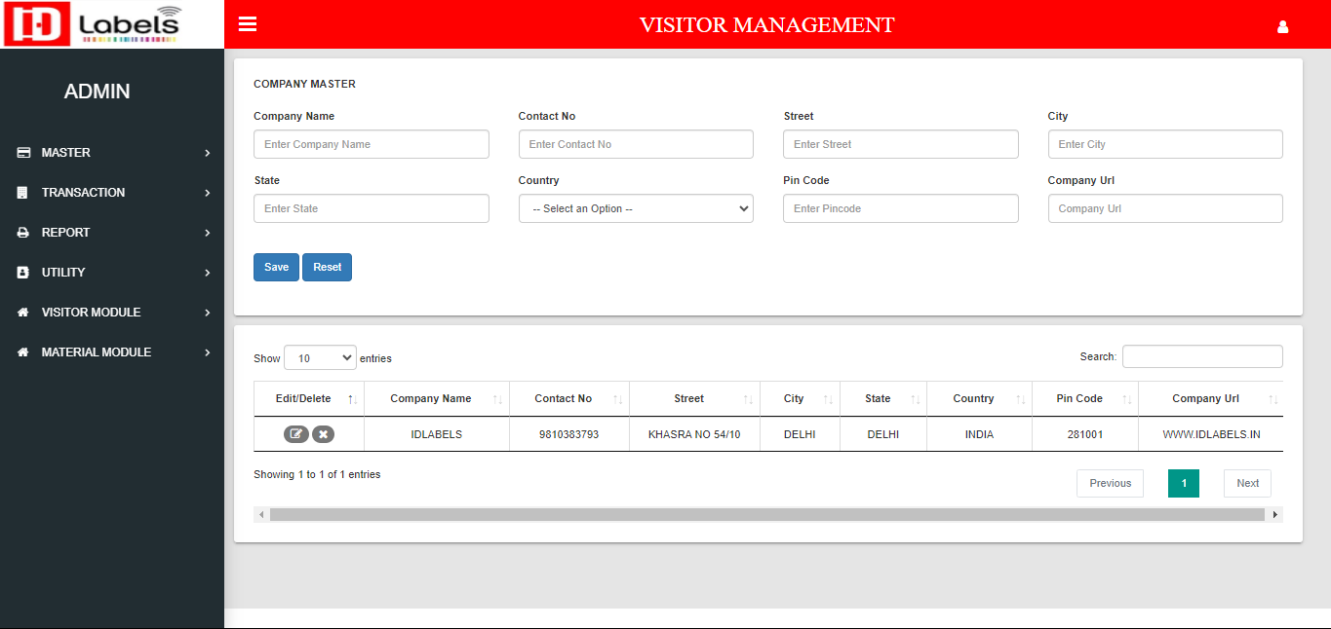
Company Master

Slide 7
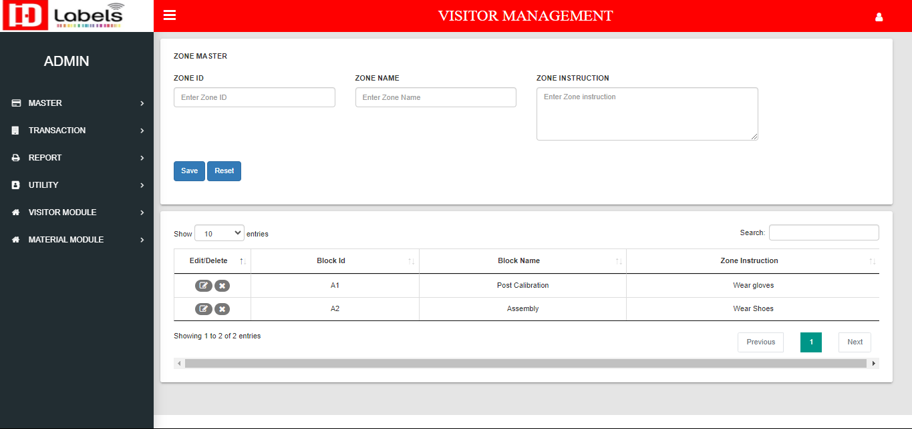
Zone Master

Slide 8
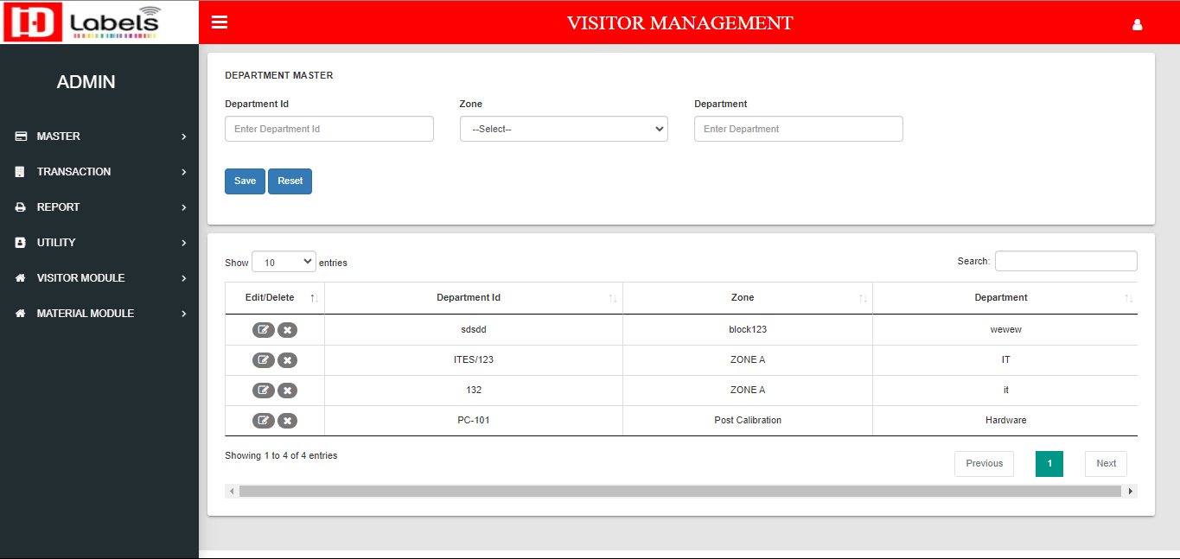
Department Master

Slide 9
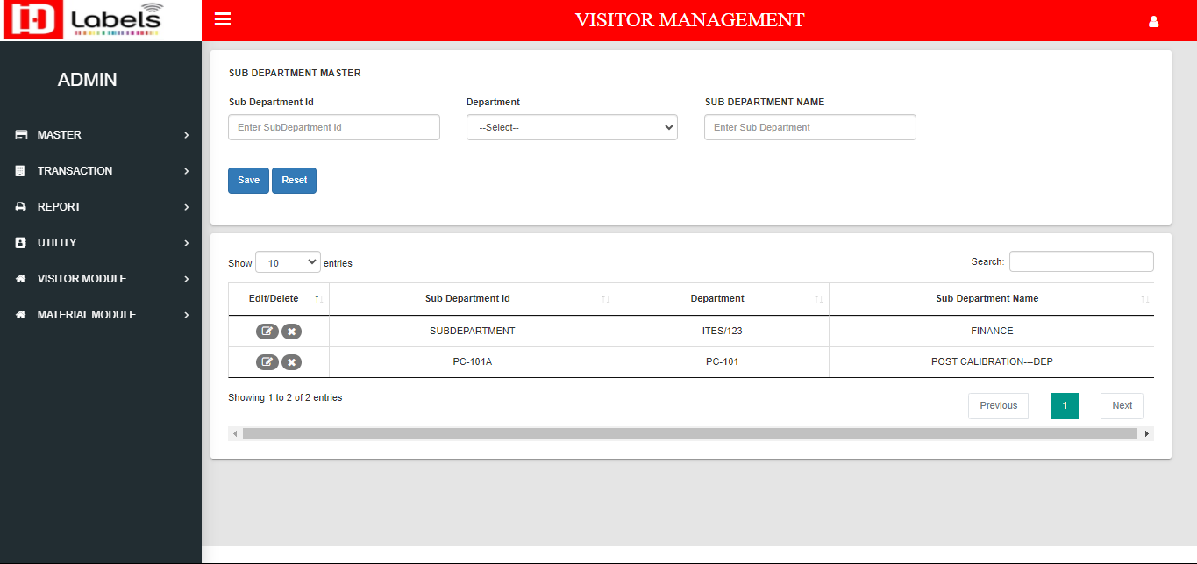
Sub-Department Master

Slide 10
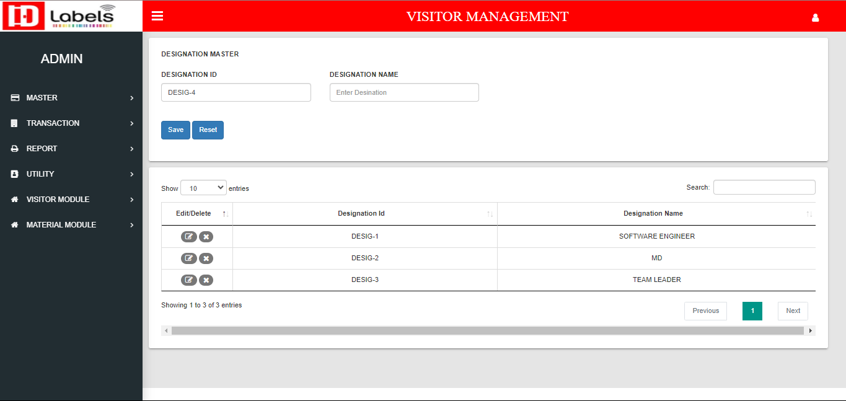
Designation Master

Slide 11
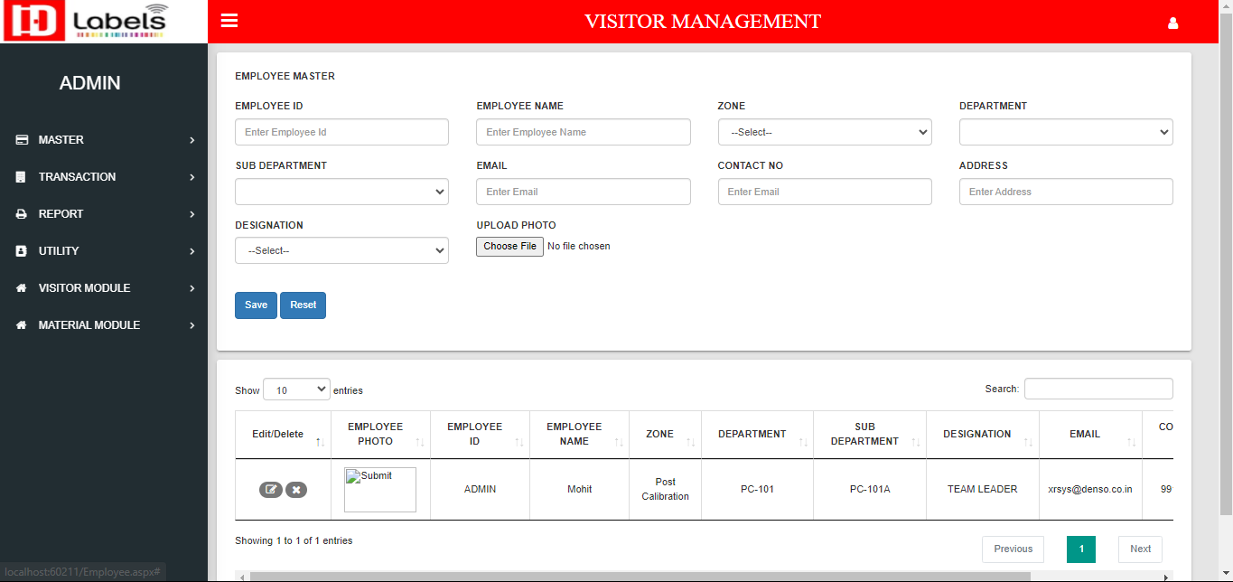
Employee Master

Slide 12
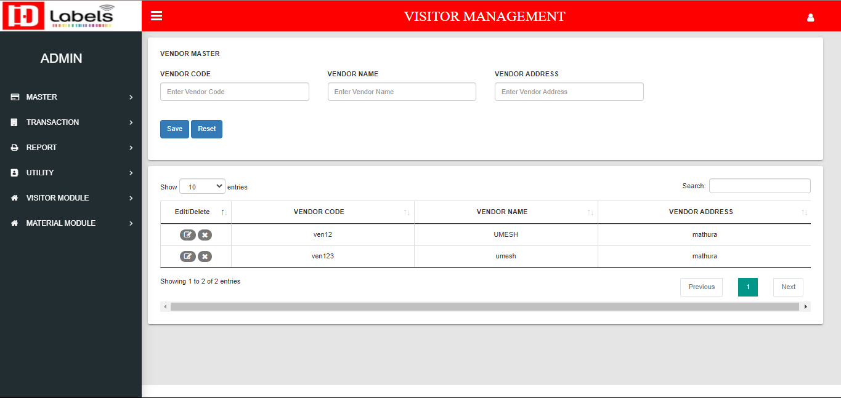
Vendor Master

Slide 13

Purpose Master

Slide 14
Returnable Item Master

Slide 15
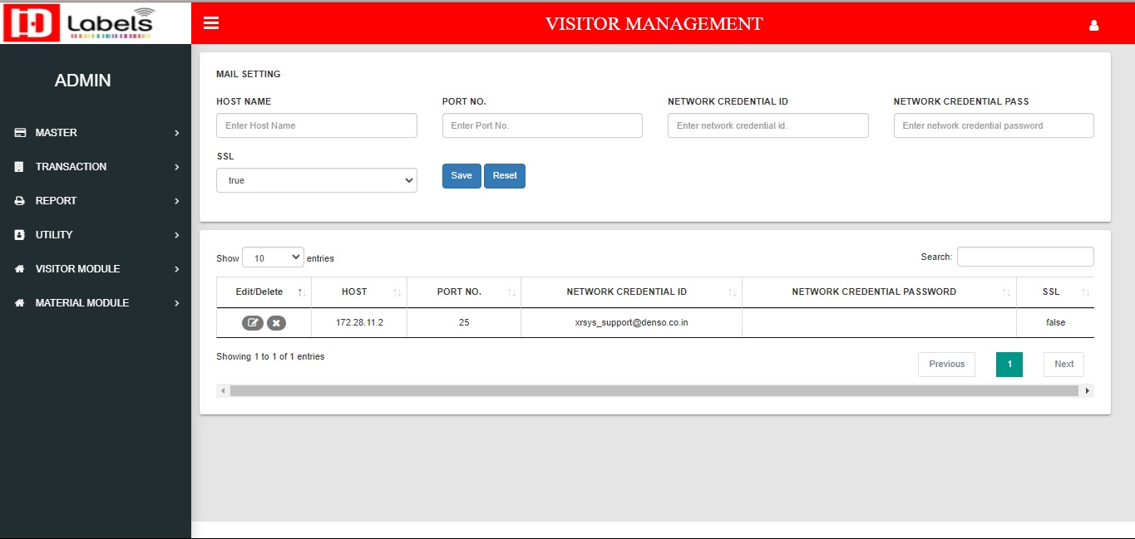
Mail Credential Setting

Slide 16
Mail Credential Setting

Slide 17
User Group Master

Slide 18
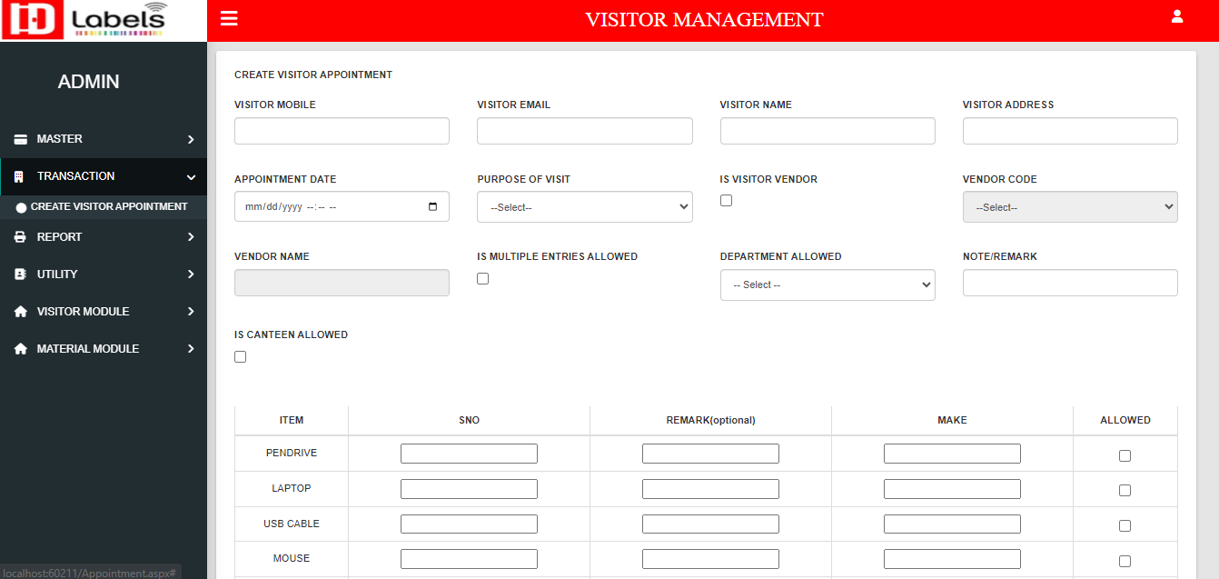
Transaction
Create Visitor Appointment

Slide 19
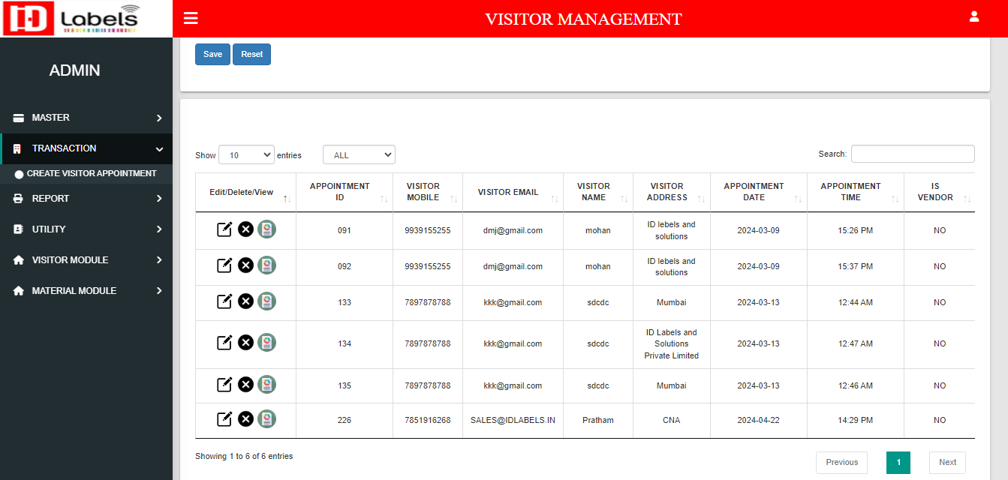
Transaction
Visitor Appointment List

Slide 20
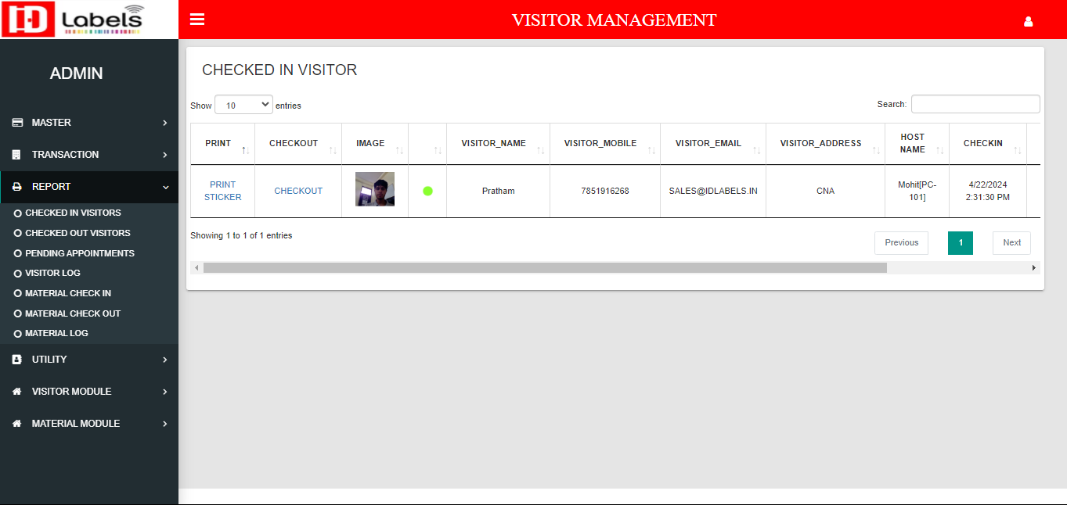
Report
Checked In Visitor

Slide 21
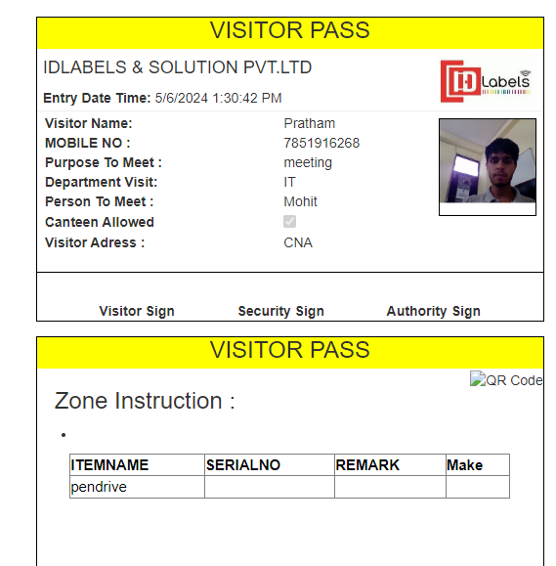
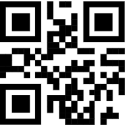
Print Visitor Pass

Slide 22
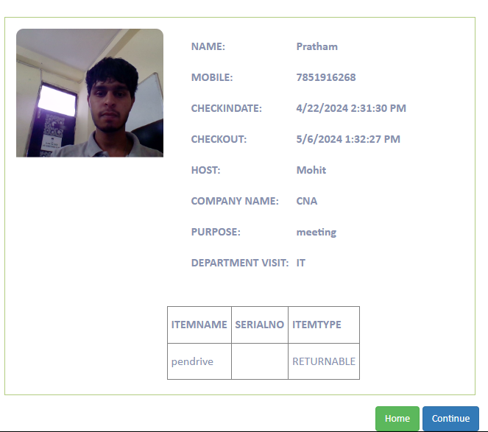
Checkout Visitor

Slide 23
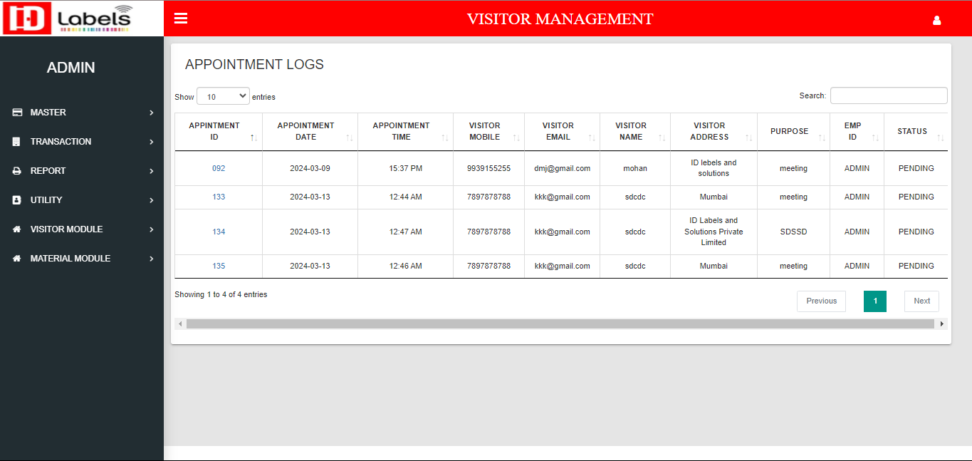
Pending Appointments

Slide 24
Visitor Log

Slide 25
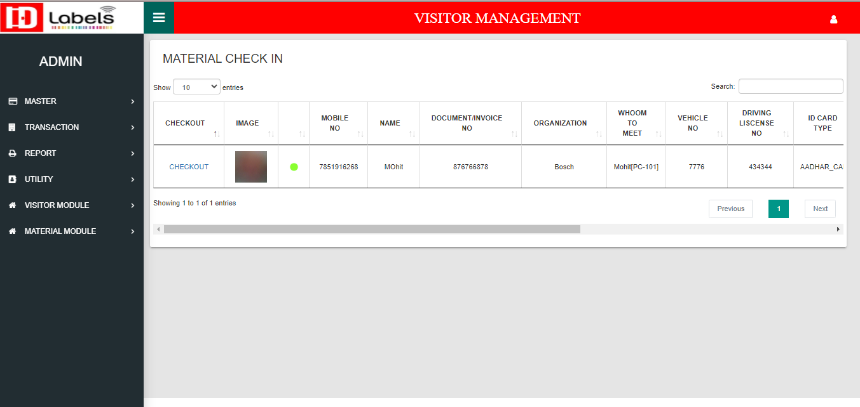
Material Checked In

Slide 26
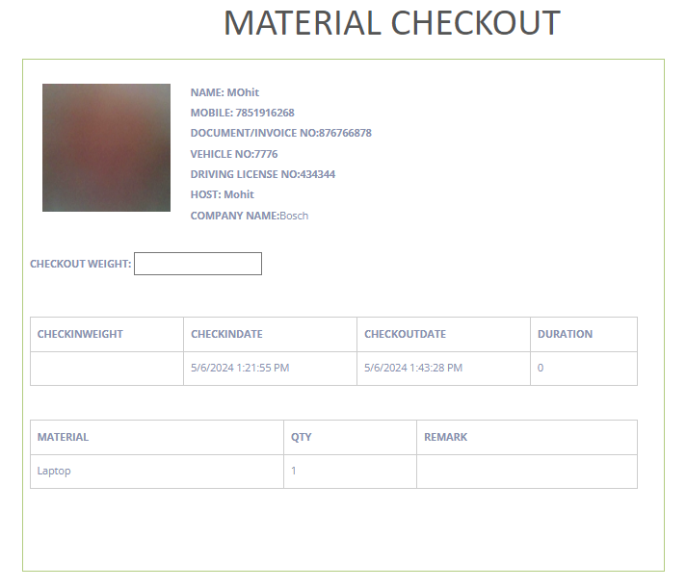
Check Out Material Using Respective link

Slide 27
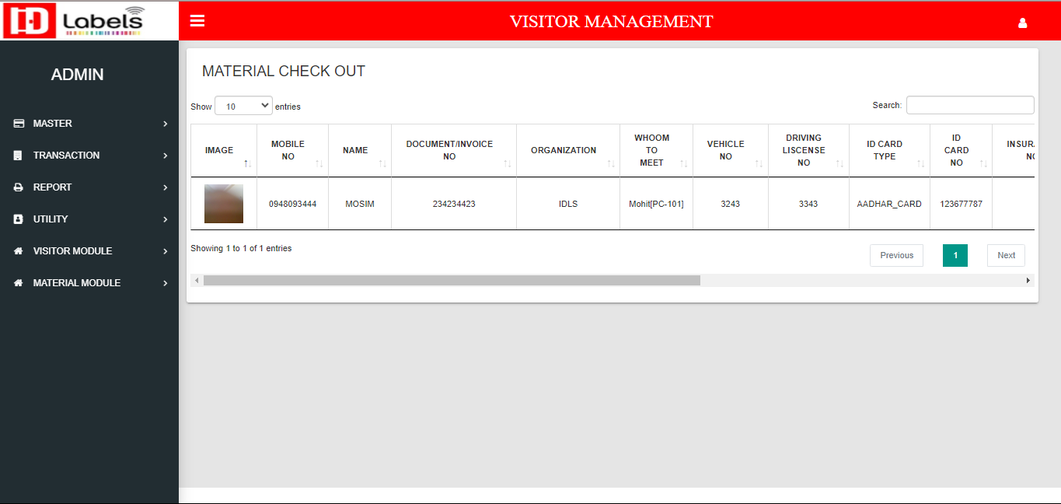
Check Out Material Report

Slide 28
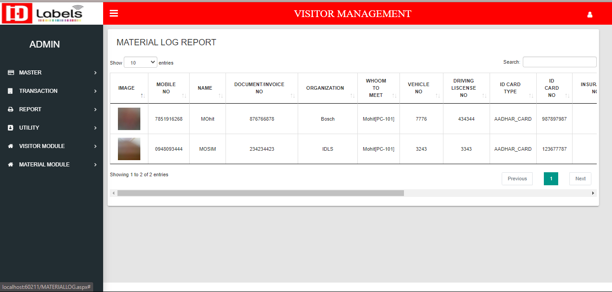
Material Log

Slide 29
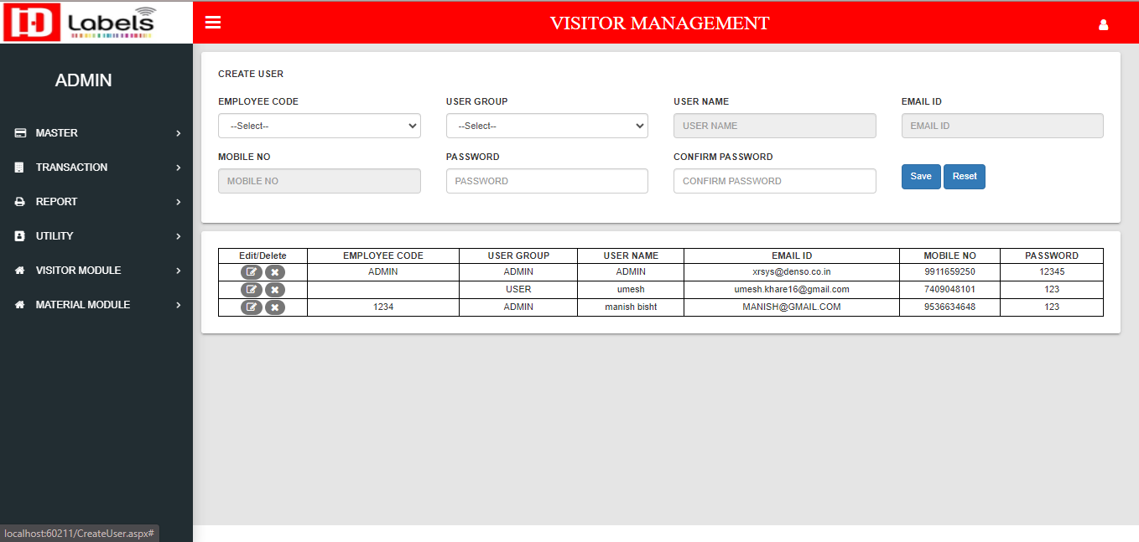
Utility
Create User

Slide 30
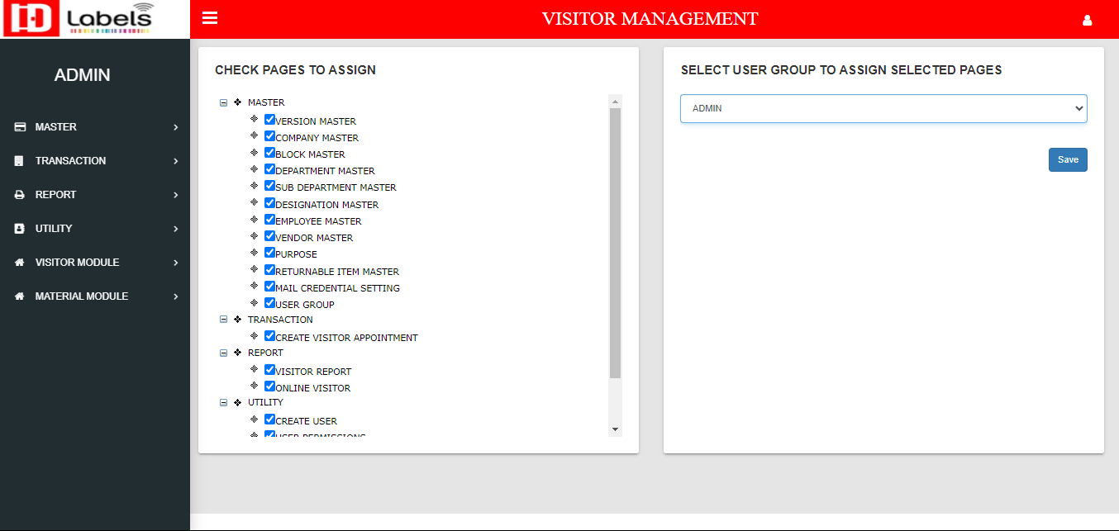
User Permission

Slide 31
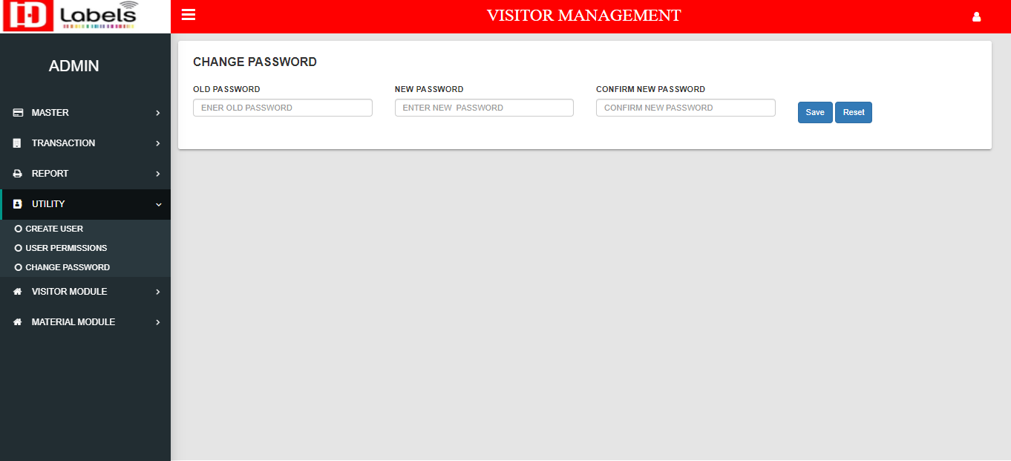
Change Password

Slide 32
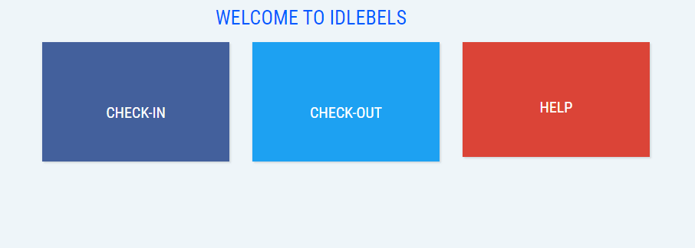
Visitor Module

Slide 33
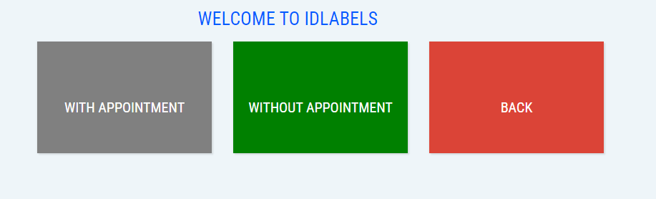
After Check-In

Slide 34
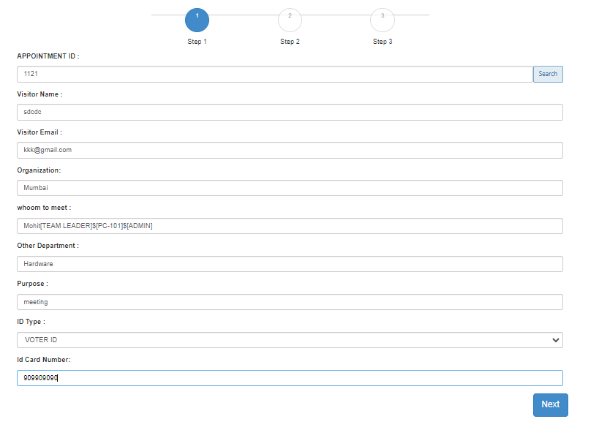
With Appointment

Slide 35
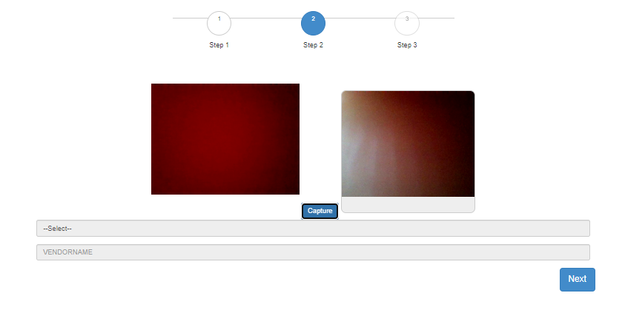
Capture visitor image

Slide 36
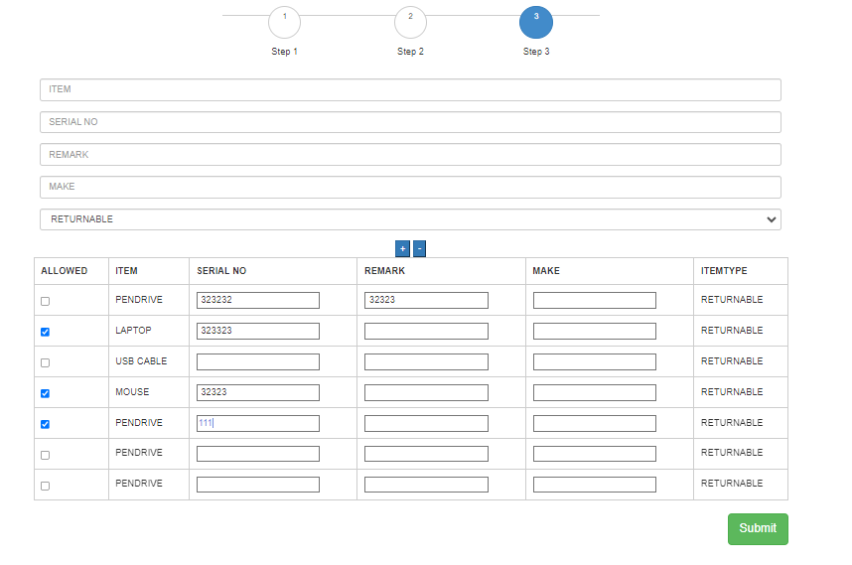
Visitor item list

Slide 37
Visitor Pass

Slide 38
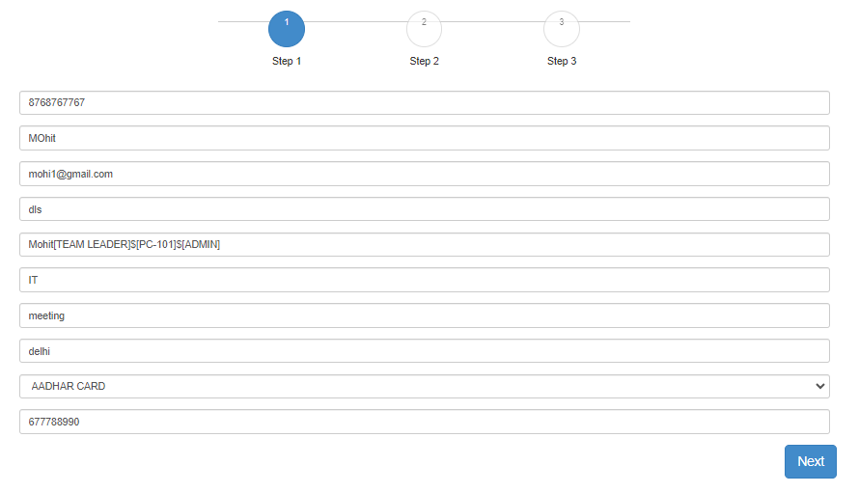
Without Appointment

Slide 39
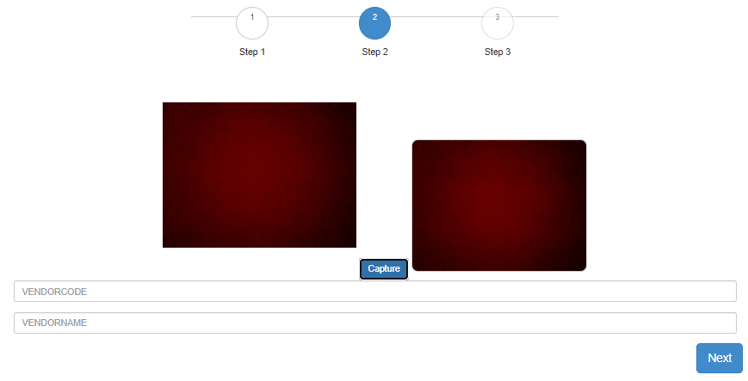
Capture image of visitor

Slide 40
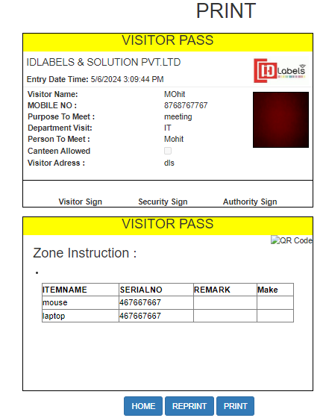
Visitor Pass Without Appointment

Slide 41
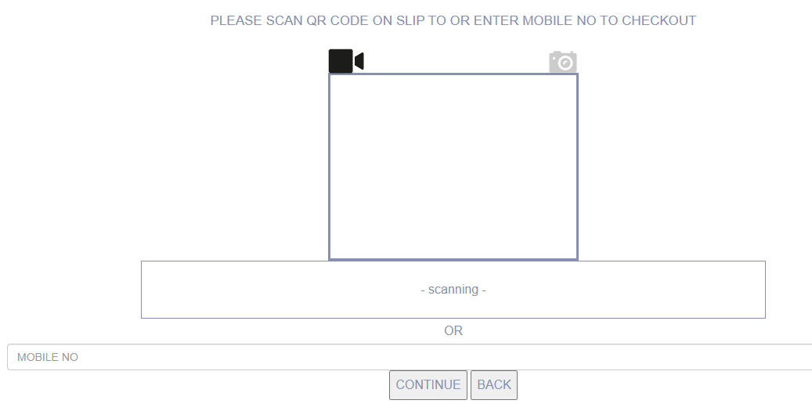
Visitor Check-Out

Slide 42
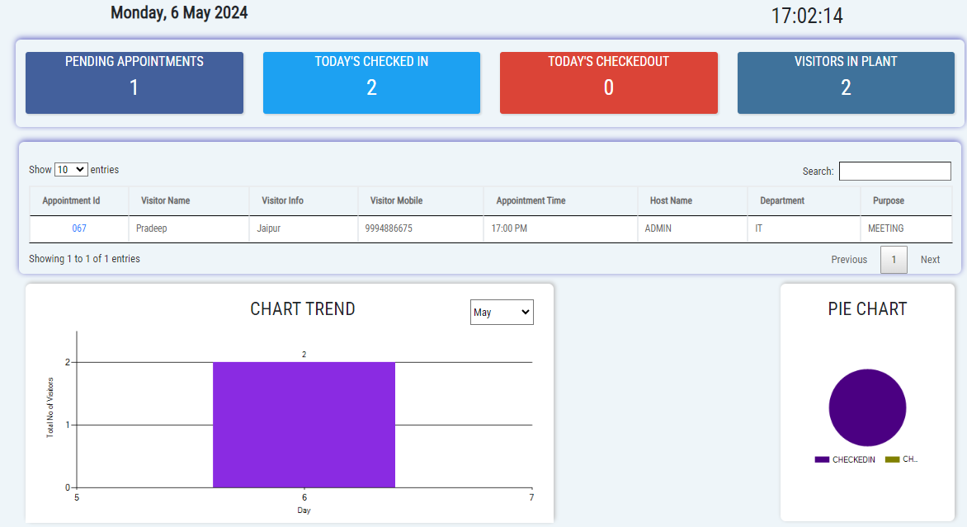
Dashboard

Slide 43
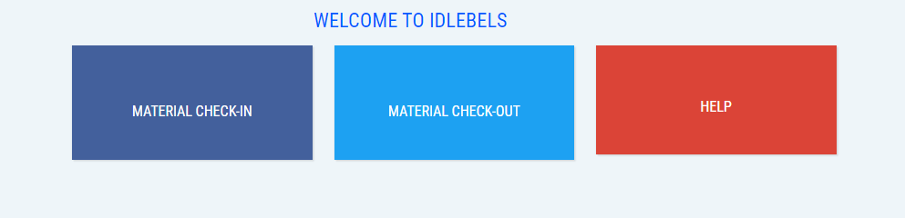
Material Module

Slide 44
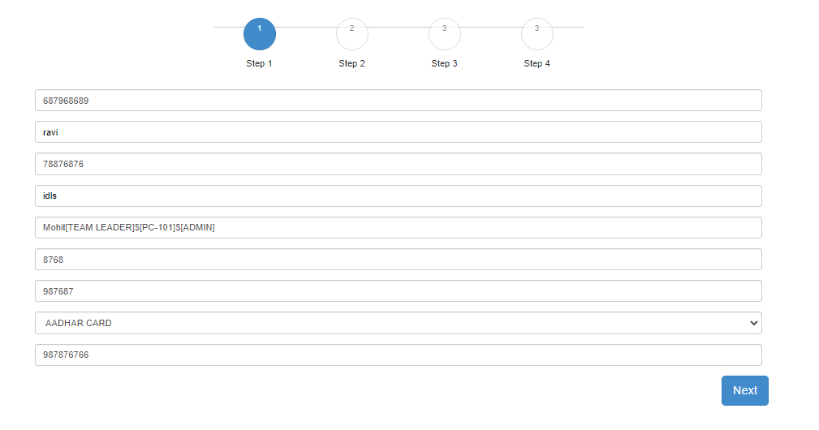
Material Check-In

Slide 45
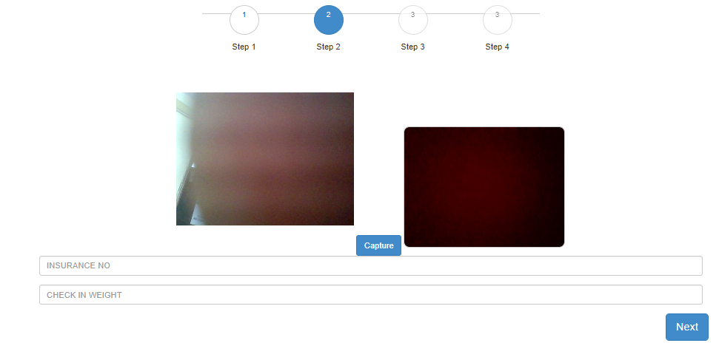
Material Check-In
Capture Image

Slide 46
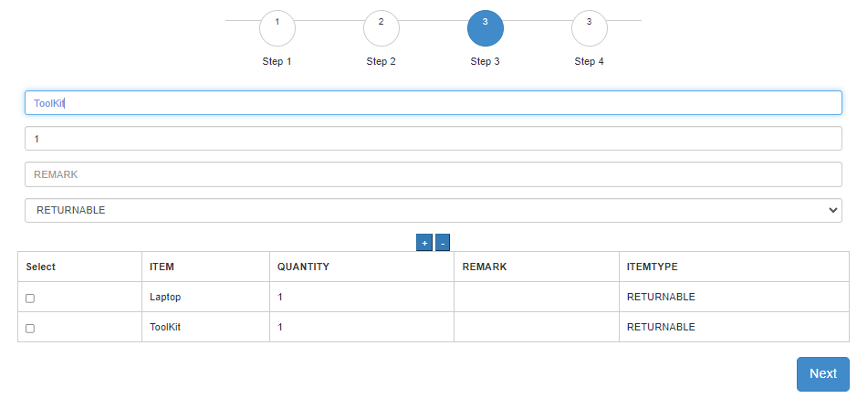
Material Check-In
Material Detail

Slide 47
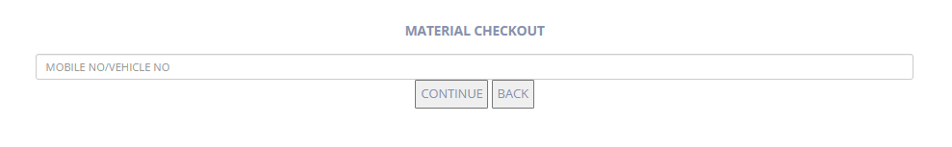
Material Check-Out

Slide 48
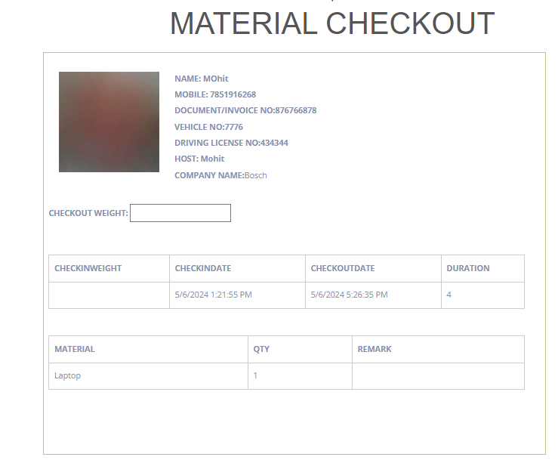
Material Check-Out

